Slide 1
Ironhack - AI Consulting & Integration
AMBOSS AI Content Creator
Group 7: Barsha Mishra, Julia Antunes, Maximilian Kempa

Slide 2


OVERVIEW
Project Motivation
Growing Industry
Ed/Healthtech offers a rich field for AI innovation
Leverage Marketing Activities
Support teams to create content in a fast paced environment
User friendly solution
Teams can easily get the desired output

Slide 3


FOUNDATION
Project Structure
Objectives (Q / T / C)
Stakeholders
Quality
Posts sounds like AMBOSS
Use only facts from our knowledge base
Clearly different from a generic AI post
High Interest and High Influence
AMBOSS Marketing & Content Team
AMBOSS Management / Project Sponsor
Project Team (AI Developers)
High Interest and Low Influence
Regional Marketing Teams
Low Interest and High Influence
AMBOSS Legal & Data Protection Team
Low Interest and Low Influence
AMBOSS Medical Editorial Team
Medical Students & Healthcare Professionals
Time
Hard deadline- final presentation on Day 3
Cost
Low-cost model (gpt-4o-mini) and stay under API spend for the whole project

Slide 4


FOUNDATION
Project Structure
Risks
WBS Mapping
Risks
Insufficient or low-quality knowledge base data
Technical integration issues with the LLM API and content pipeline
Structure & board
Set up, brainstorm and Trello
Knowledge bases
Primary markdown and Secondary markdown set
Ingest & context
Markdown loader and Prompts
Generate & differentiate
Running LLMs
End-to-end Pipeline
Testing and fine tuning
Final Adjustments and Output
Data
Insufficient or low-quality knowledge base data
Integration
Technical integration issues with the LLM API and content pipeline
Bottlenecks
Delays caused by limited development time and task dependencies
Time
Hard deadline- final presentation on Day 3
Cost
Low-cost model (gpt-4o-mini) and stay under API spend for the whole project

Slide 5
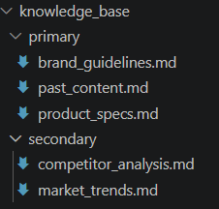
FOUNDATION
Knowledge Base Architecture
Website & Social Media
Reference channels for prompting. US official channels for easier language understanding.
Primary
“write a brand_guidelines.md for AMBOSS company, based on their us instagram (@amboss_med) and website channels(amboss.com/us)”
Secondary
“write competitors analysis on https://www.amboss.com/us also with USPs, be short and concise. Find real data with facts, numbers and other business metrics”
No RAG usage: Project’s knowledge base is small and stable, so simpler method, injecting all into the prompt, works.

Slide 6




TECHNICAL
Implementations
Prompts
agens.md file
Stack
Reusable templates generate content for marketing channels
Prompts include knowledge-base context, audience, language, tone, and content strategy
Channel-specific rules guide format and length
Accuracy rules require supported AMBOSS facts and prohibit unsupported medical claims
Revision prompts apply reviewer feedback while preserving the original requirements
Agents file rule AI coding agents
stack, the run command
which file does which job
and a never-do list (e.g.: .env file)
Language
Python 3 (conda environment)
LLM
OpenAI API, gpt-4o-mini
Libraries
openai, python-dotenv
Knowledge base
Markdown files
Interface
Terminal (python -m src.main)
Teamwork
Git + GitHub, Trello (Kanban), agents.md for AI coding agents

Slide 7
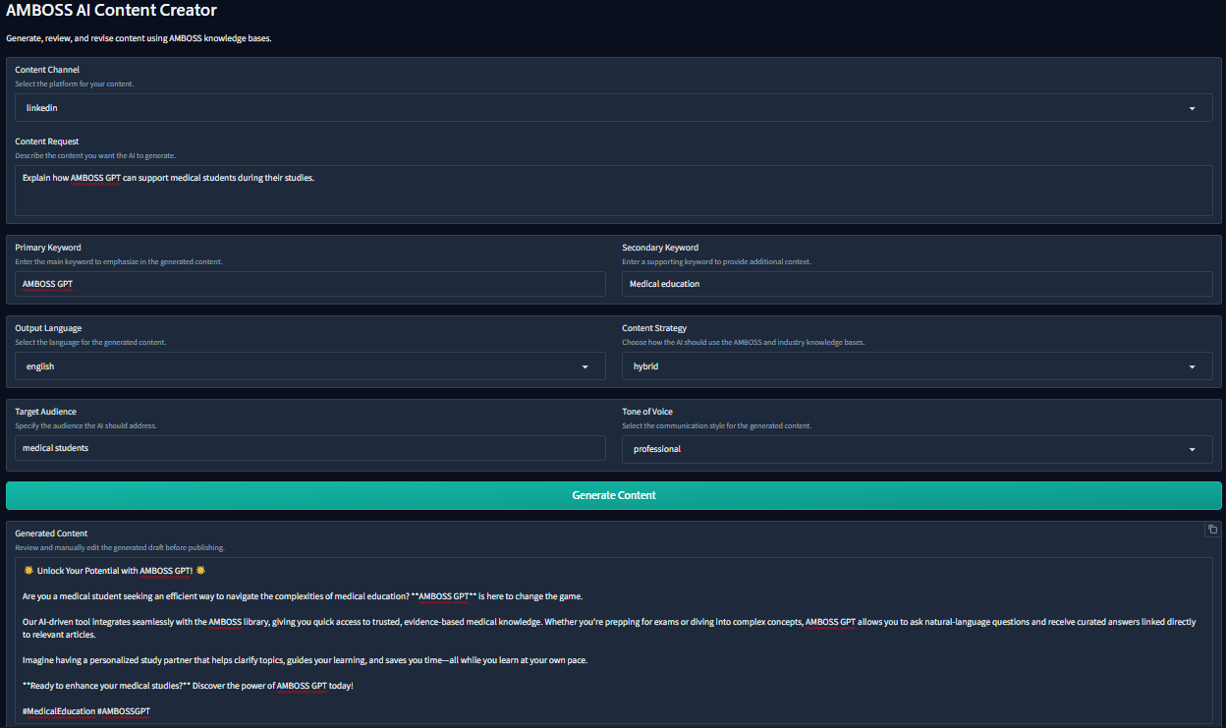
DEMONSTRATION
Pipeline

Slide 8
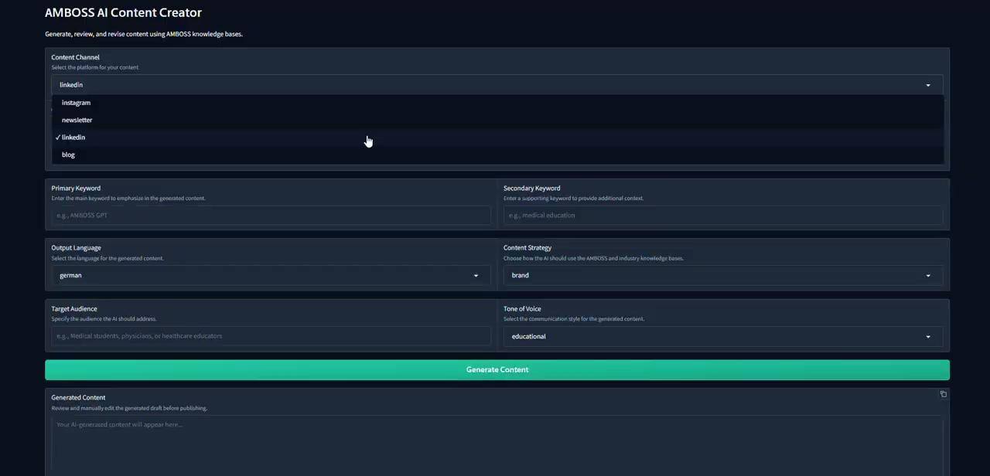

Slide 9
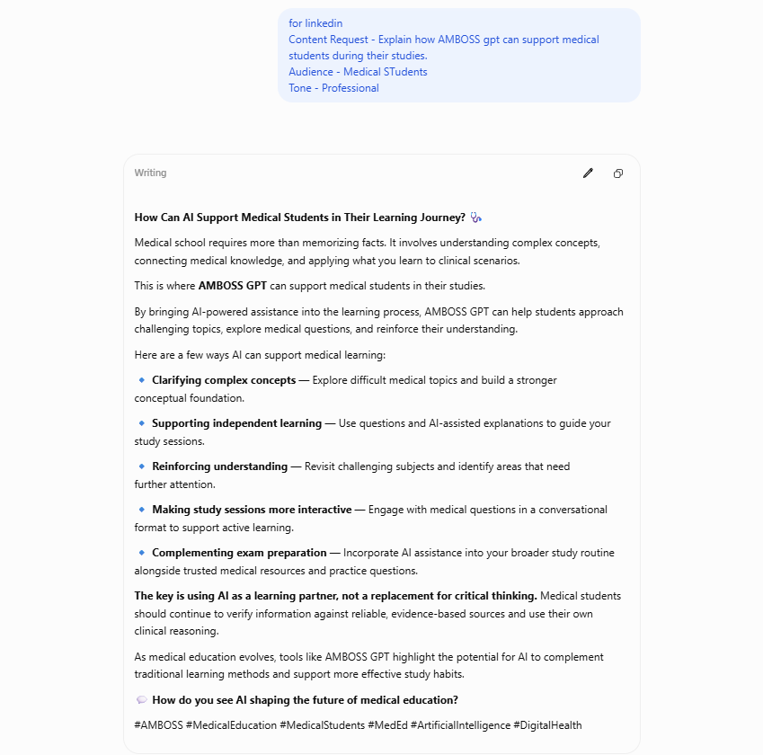
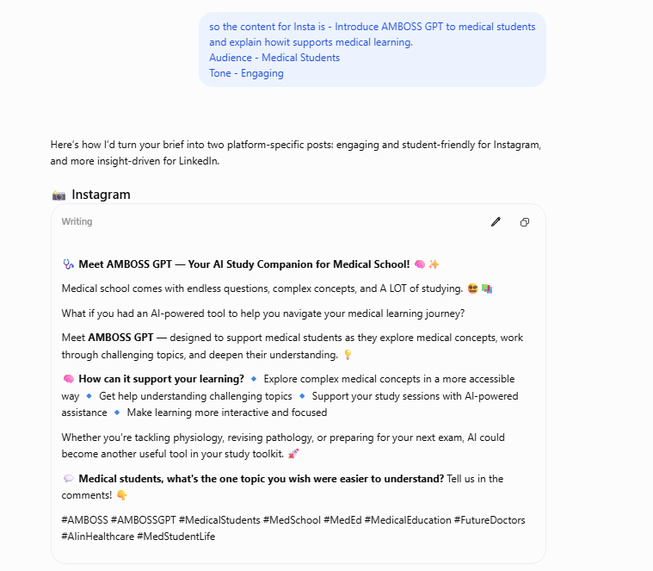
DEMONSTRATION
Uniqueness

Slide 10
Challenges faced & solutions
Challenges
Solutions
Github collab work
GenAI support
Still a learning process
Usage of GenAI tools to help with Github understanding
How to share the work
Prioritization + dynamic work
Due to the project size, workload division can be challenging
Knowledge base tasks shared likewise as a starting base, followed by dynamic collaboration
Set up and start
Ironhack support
Part of the process that took the longer
Followed the bootcamp step-by-step material

Slide 11
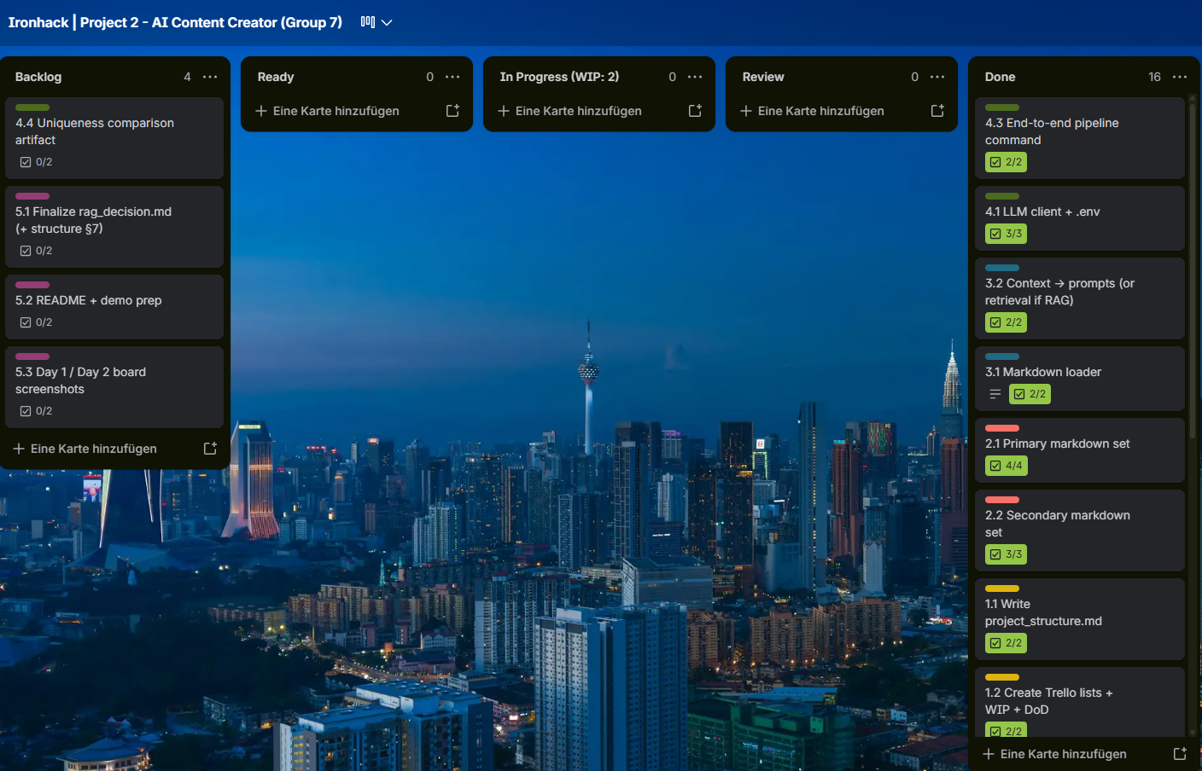
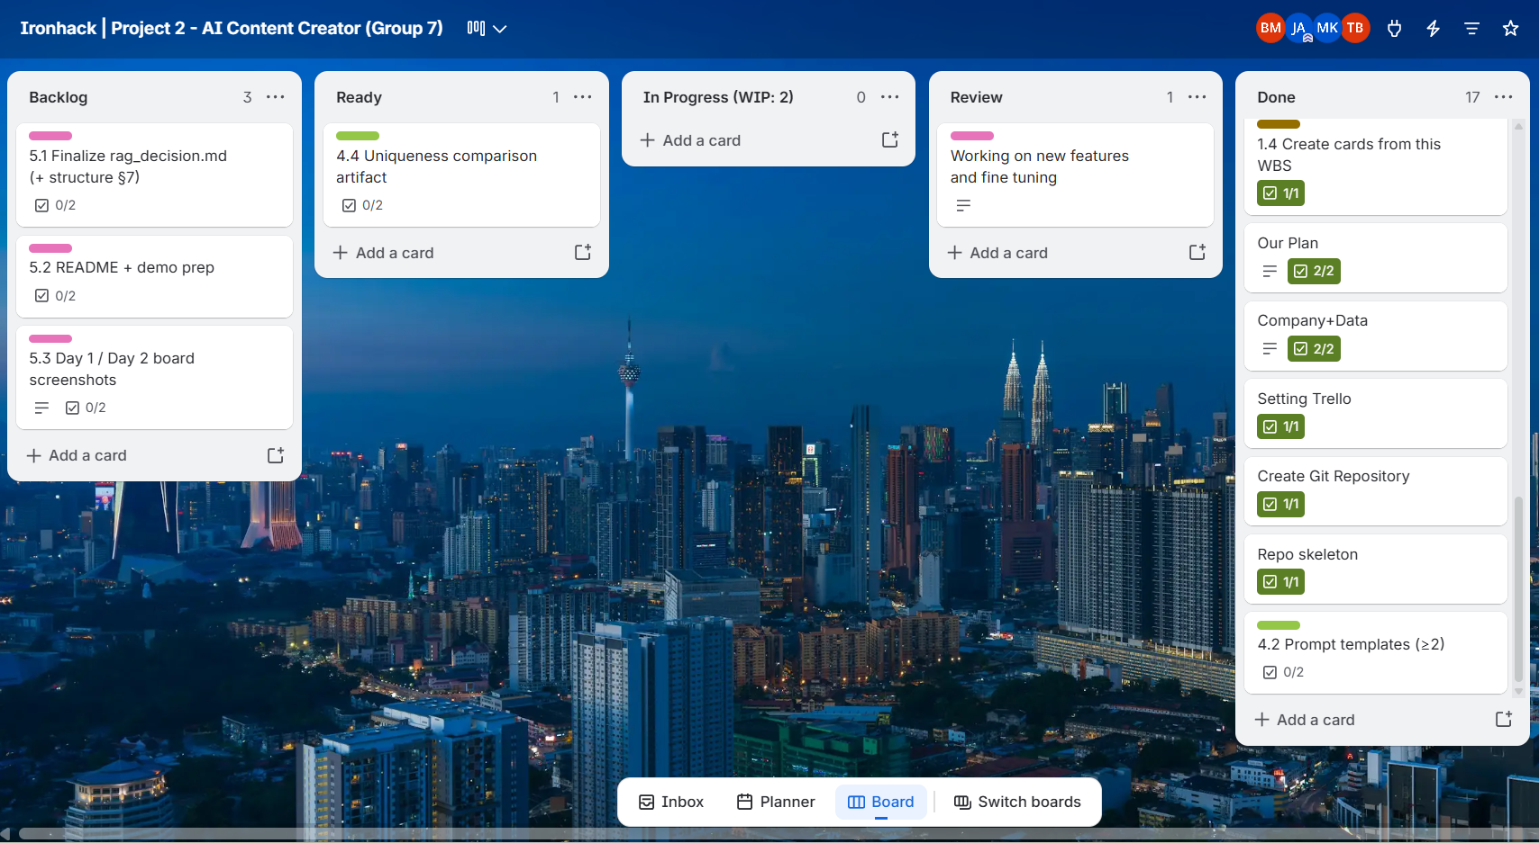
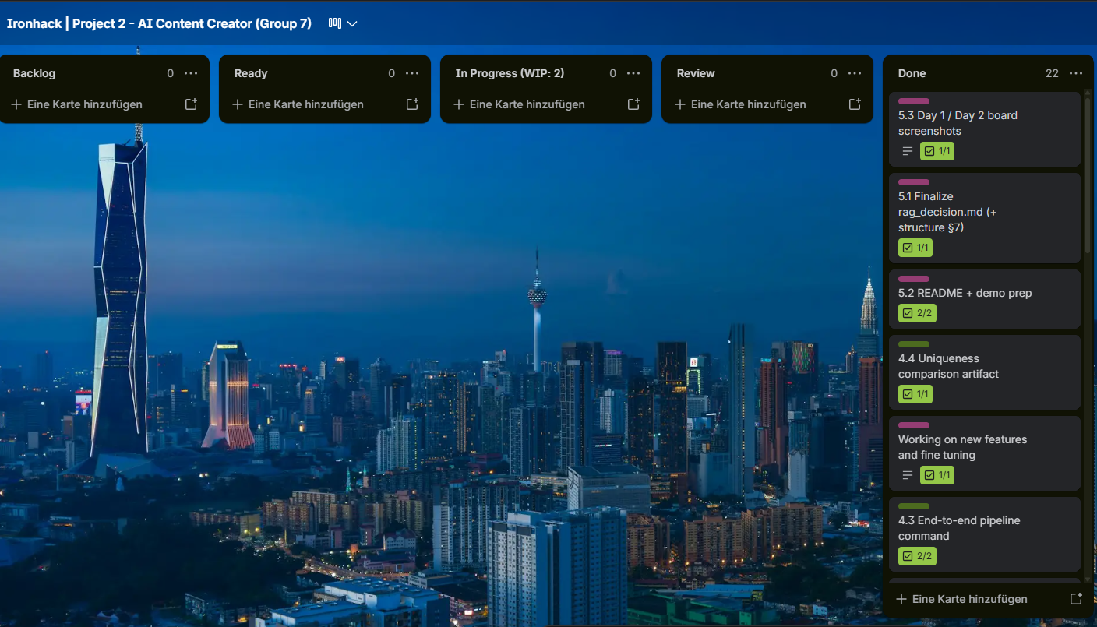
Day 1 End of the day
Kanban Board
Day 2 Work in progress
Day 1: Understanding & Organising
WBS and Dod
Day 2: Flow
Day 2 End of the day
Updating progress and reaching goals

Slide 12
Thank you!
Questions?

